Slide 1

By JAGVEER SINGH
Business Analyst Career Program - Capstone Project

Slide 2

Agenda
Data Exploration
Statistical Analysis using Excel
Graphical Analysis using Excel
Insert the given data into the SQL server
Import the Data from the SQL Database into PowerBI
Interactive Dashboard by using visualization tools
Conclusion and Inferences
Endnotes

Slide 3
Data Exploration
It is Financial Data of western countries .
It has mainly segment of Channel Partners, Enterprises, Government, Midmarket, Small Business.
The dataset is of countries are Canada, France, Germany, Mexico, United state of America.
The products are Amarilla, Carretera, Montana, Paseo , Velo, VIT.
Gross Sales = Unit Sold * Sales Price.
Sales = Gross Sales – Discount.
Profit = Sales – COGS.
Years are 2013 and 2014

Slide 4
Statistical Analysis using Excel
Product by sales :
Amarilla - $1,77,47,116.06 , Carretera – $1,38,15,307.89, Montana – $1,53,90,801.88, Paseo – $3,30,11,143.95,
Velo – $1,82,50,059.47, Vit – $2,05,11,921.02.
--Most Selling Product is Paseo.
Segment wise Profit :
Channel Partners - $13,16,803.14, Enterprise – $(6,14,545.63), Government – $1,13,88,173.17, Midmarket – $6,60,103.08,
Small Business – $41,43,168.50.
--Most Profit Segment is Government and Having a Loss in Segment of Enterprise.
Yearly sales and Profit:
2013 2014
Sale : $2,64,15,255.51 Sale : $9,23,11,094.75
Profit : $38,78,464.51 Profit : $1,30,15,237.75
--We Have More Sales and Profit in year 2014.
Country wise sales :
Canada - $2,48,87,654.89, France - $2,43,54,172.28, Germany - $2,35,05,340.82, Mexico - $2,09,49,352.11,
United state of America - $2,50,29,830.17.
--Top 2 Countries According to Sales is U.S.A and Canada.

Slide 5
Statistical Analysis using Excel
Bottom 3 Products :
Carretera, Montana , Amarilla.
Product wise Discount :
Amarilla - $12,90,163.44, Carretera – $11,22,212.62, Montana - $11,59,032.62, Paseo - $26,00,518.05,
Velo – 15,76,709.04, Vit – 14,56,612.48.
--Most Discount offered in Product is Paseo
No. of units sold year over year
2013 : 264674.
2014 : 861132.
Sales are high in year 2014.

Slide 6
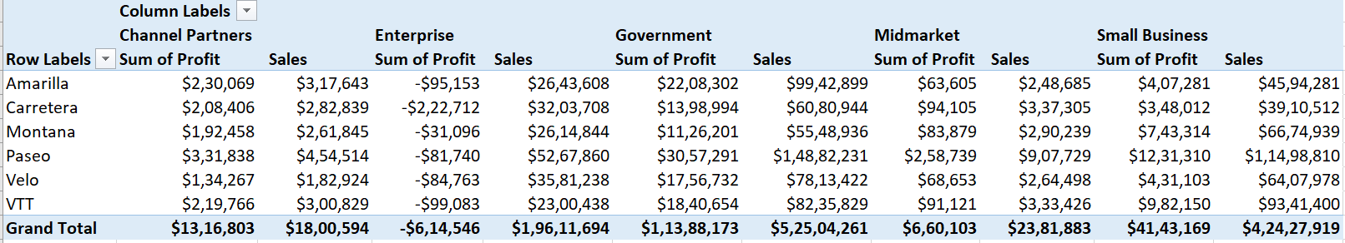
Statistical Analysis using Excel
Segment wise product sale and Profit.

Slide 7
Graphical Analysis using Excel
Most selling Product is Paseo.
Highest segment profit is Government and product is Paseo , and having highest loss segment is Enterprise and product is Carretera.
More sale and Profit is in Year 2014.
Top 2 Countries are U.S.A and Canada.
Bottom 3 Products are Carretera, Montana, Amarilla.
More sale and Profit are in Product is Paseo.

Slide 8
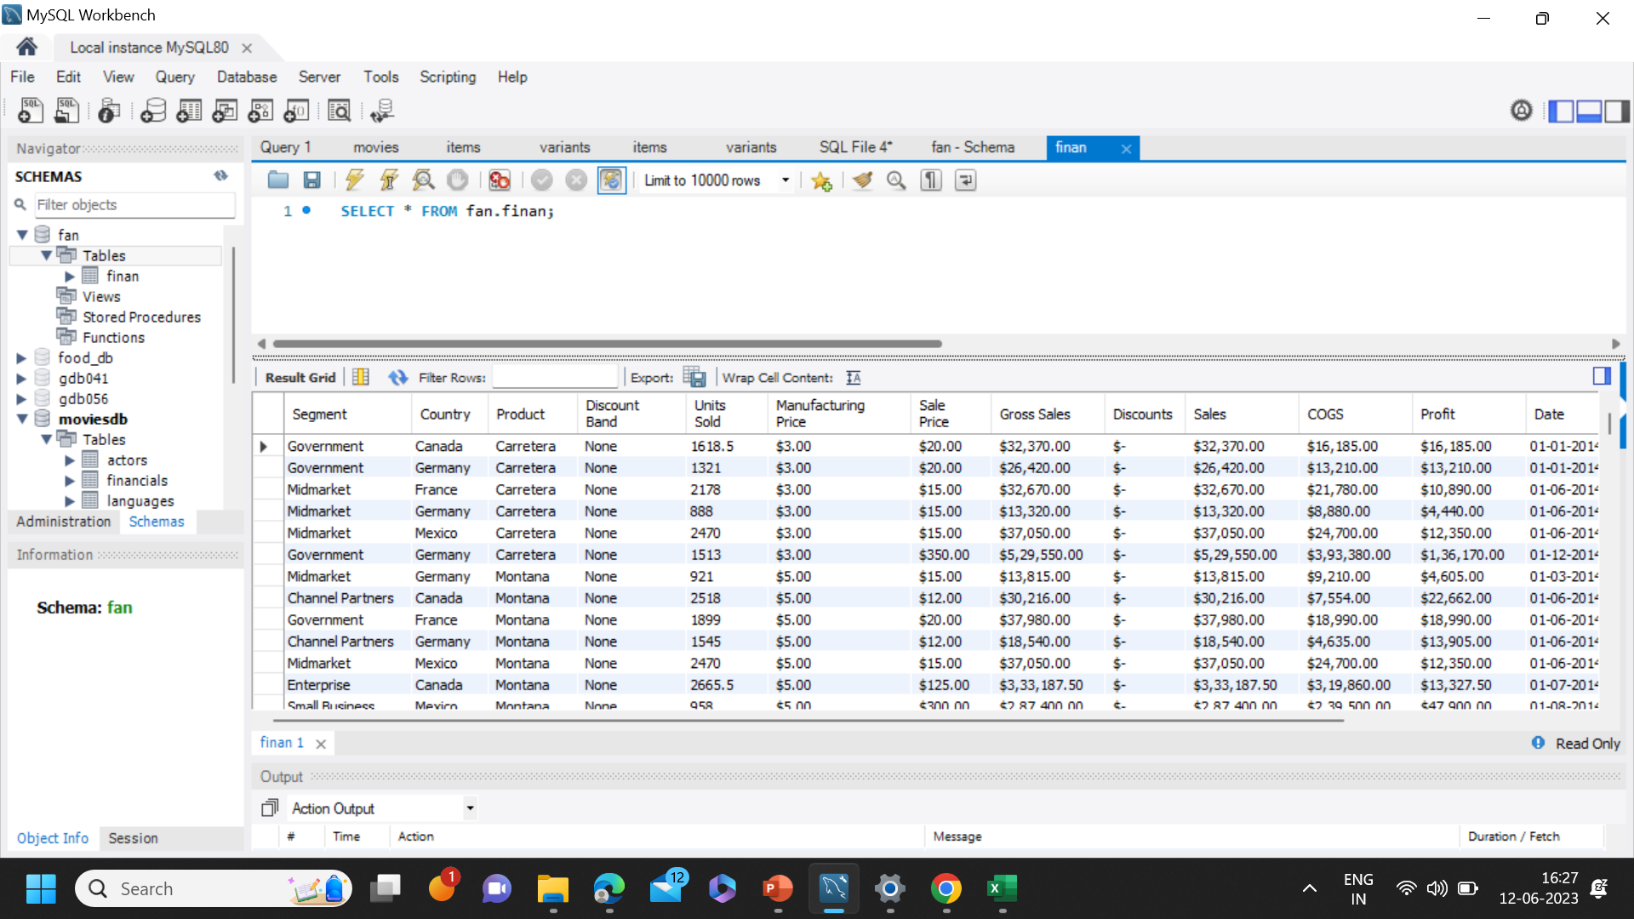
Insert the given data into the SQL server

Slide 9
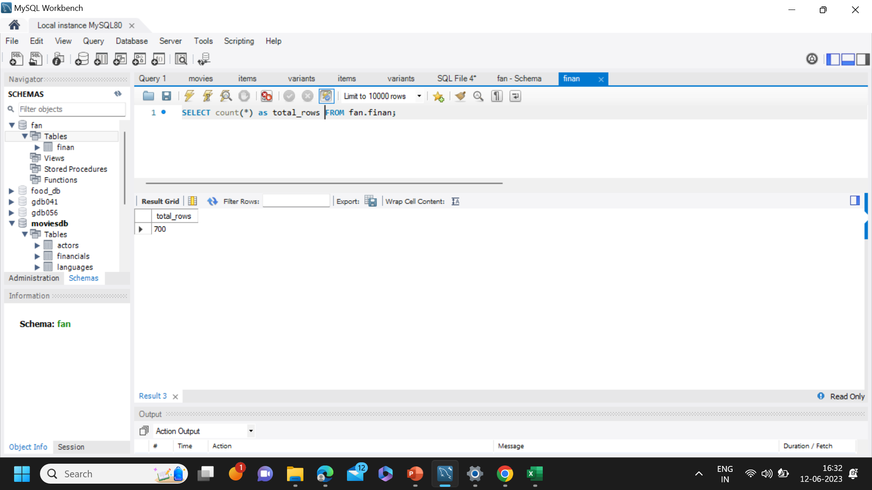
Run Query into SQL

Slide 10
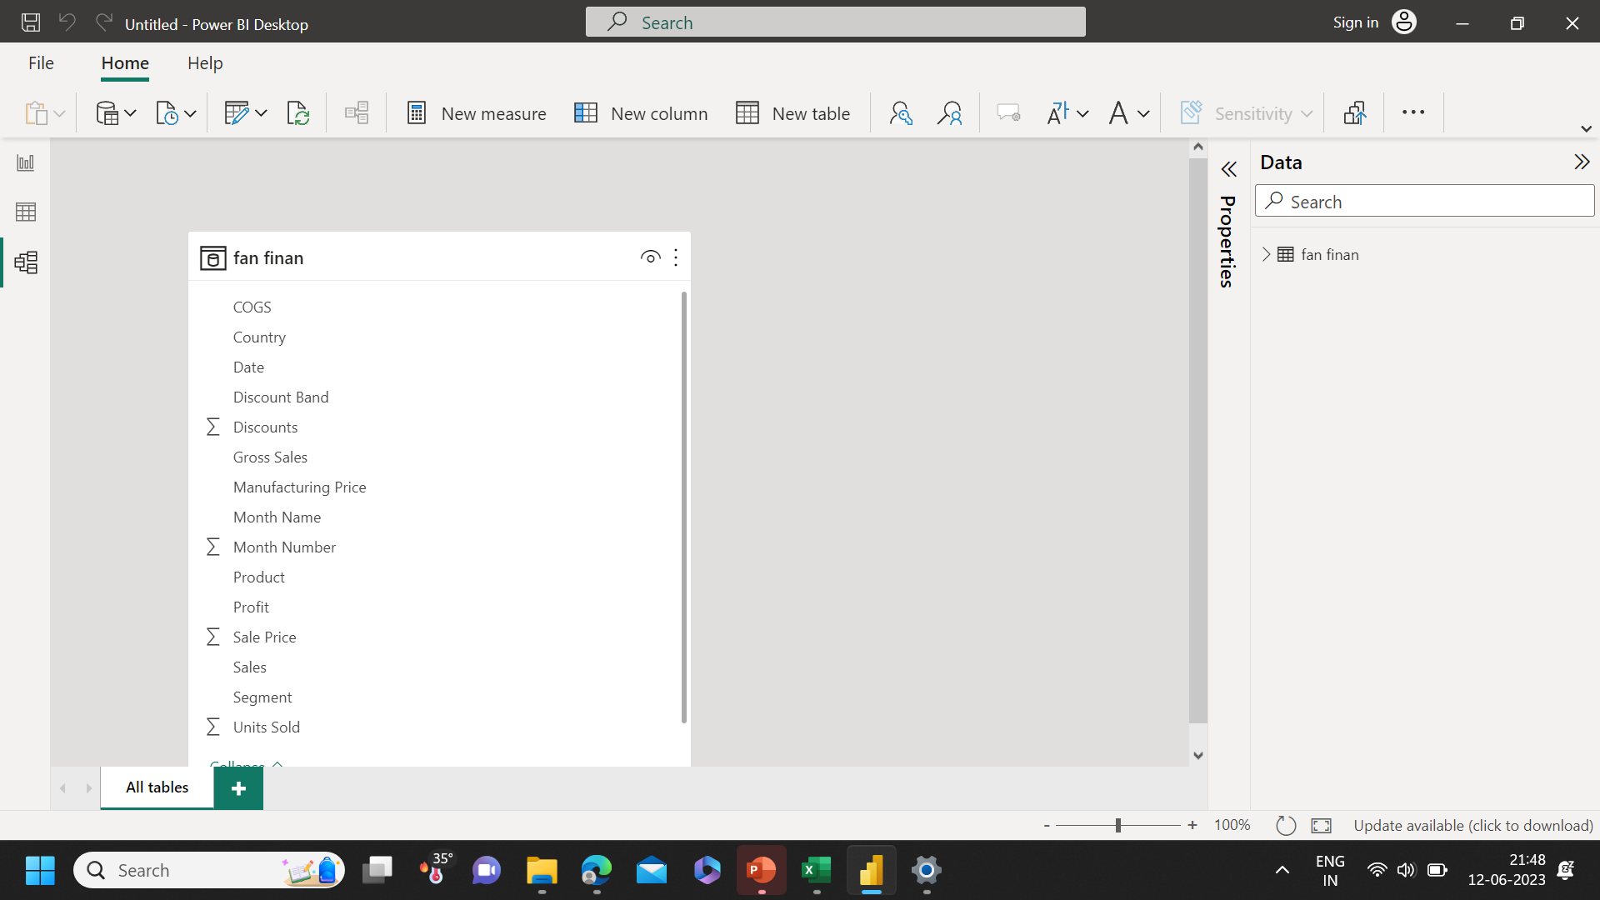
Import the Data from the SQL Database into PowerBI

Slide 11
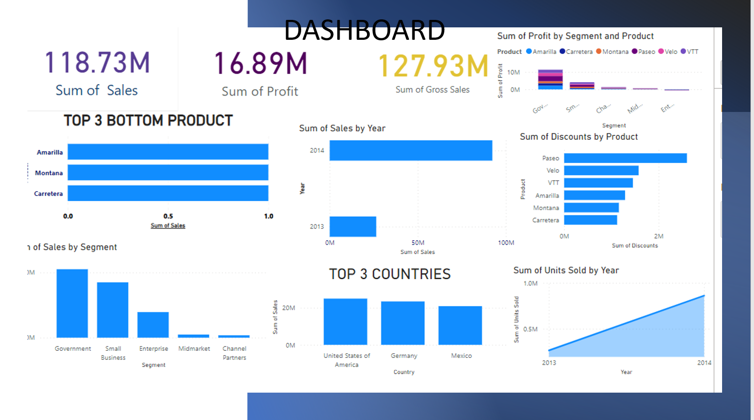
Interactive Dashboard by using visualization tools

Slide 12
Conclusion and Inferences
Most selling Product is Paseo.
Highest segment profit is Government and product is Paseo , and having highest loss segment is Enterprise and product is Carretera.
More sale and Profit is in Year 2014.
Top 2 Countries are U.S.A and Canada.
Bottom 3 Products are Carretera, Montana, Amarilla.
More sale and Profit are in Product is Paseo.

